Slide 1

Deterministic QMIX - Multi-Agent Reinforcement Learning with Continuous Actions
Ipek Ilayda Onur, Tony Huang
April 26, 2023

Slide 2
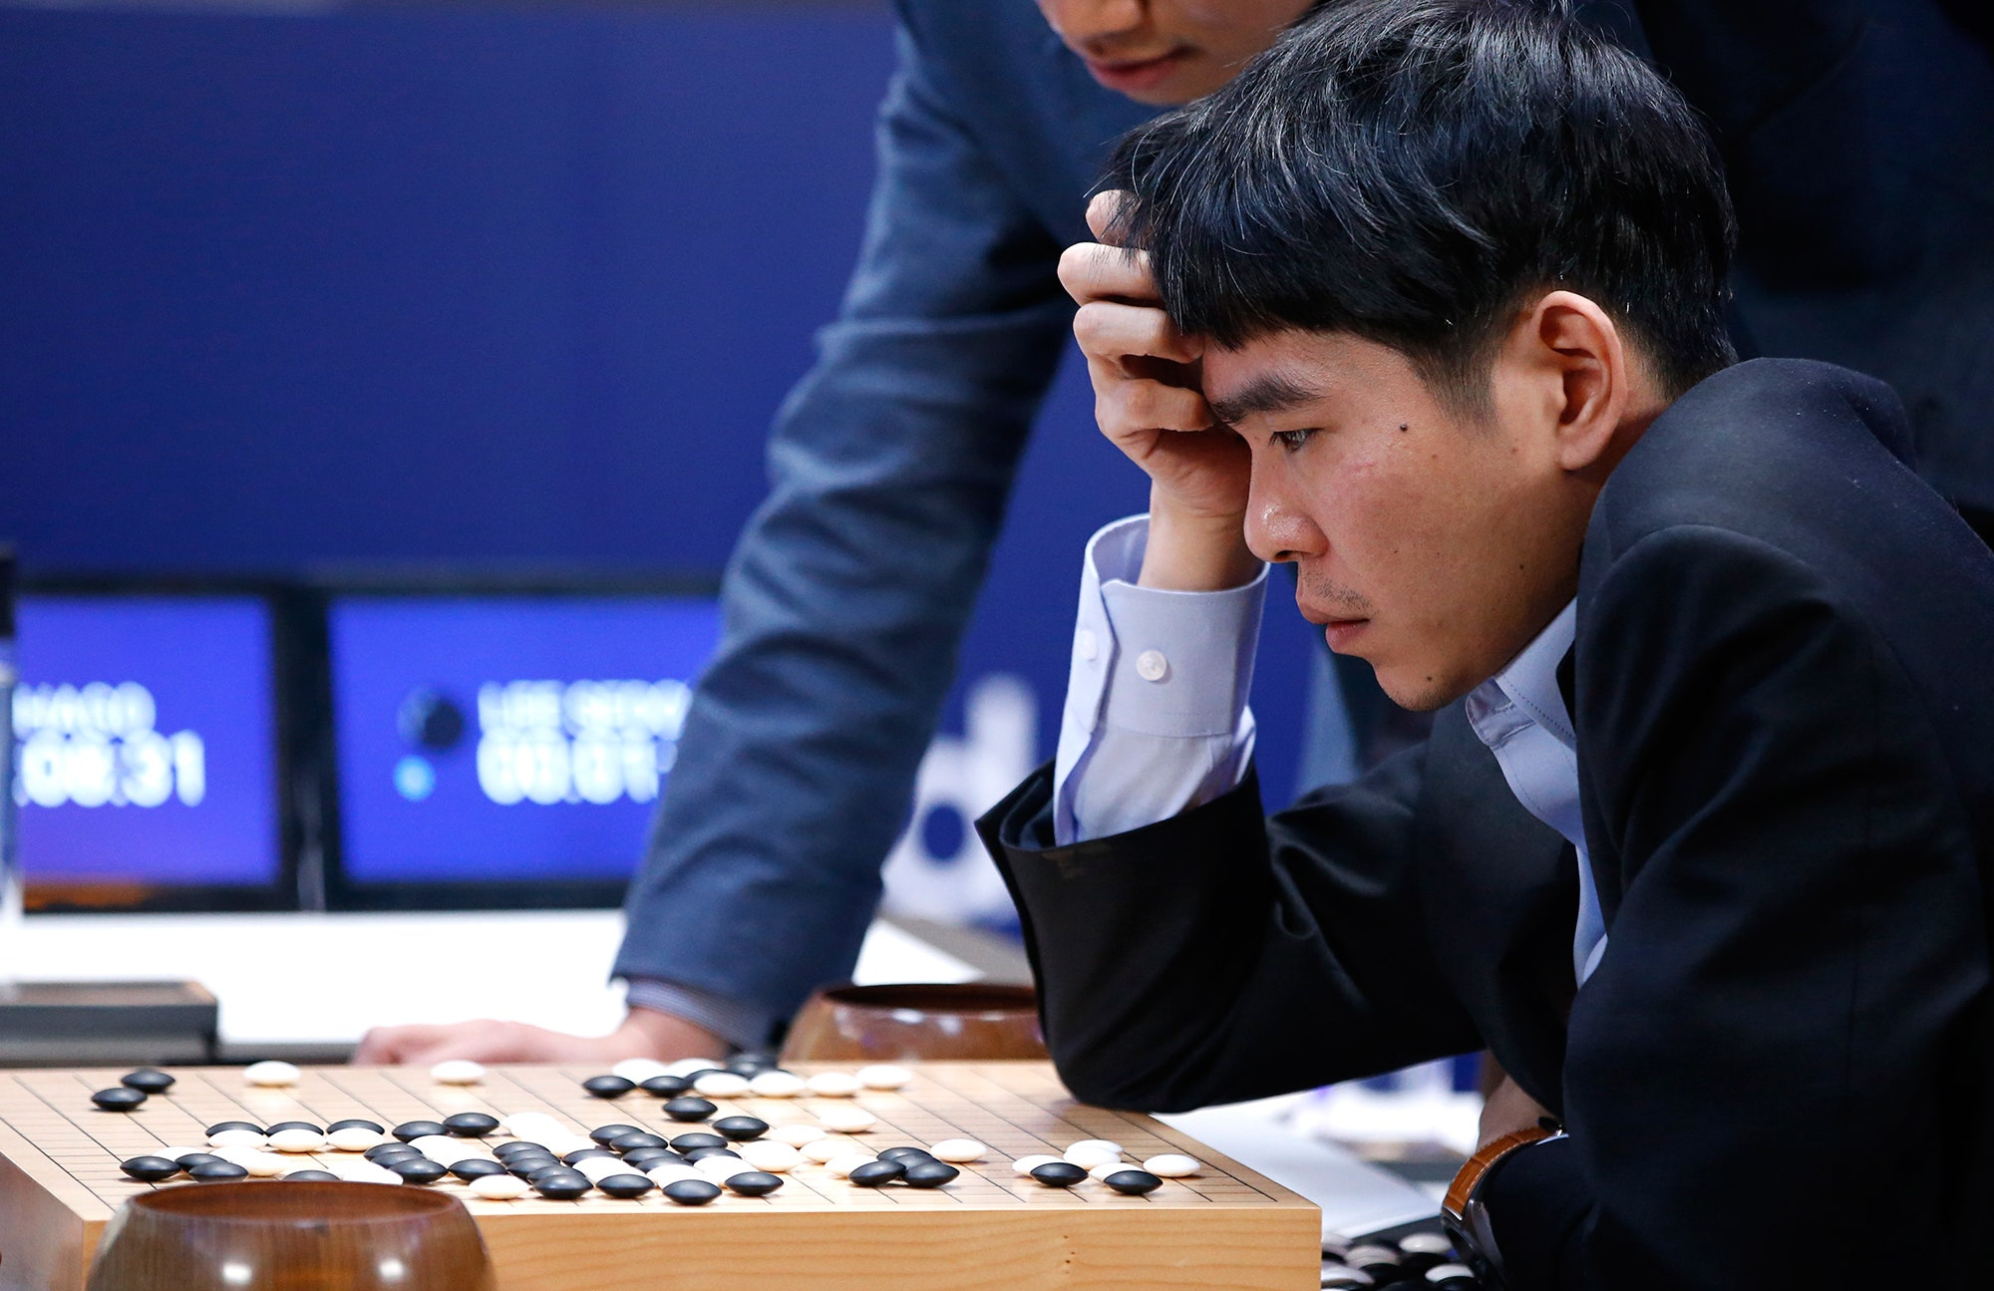
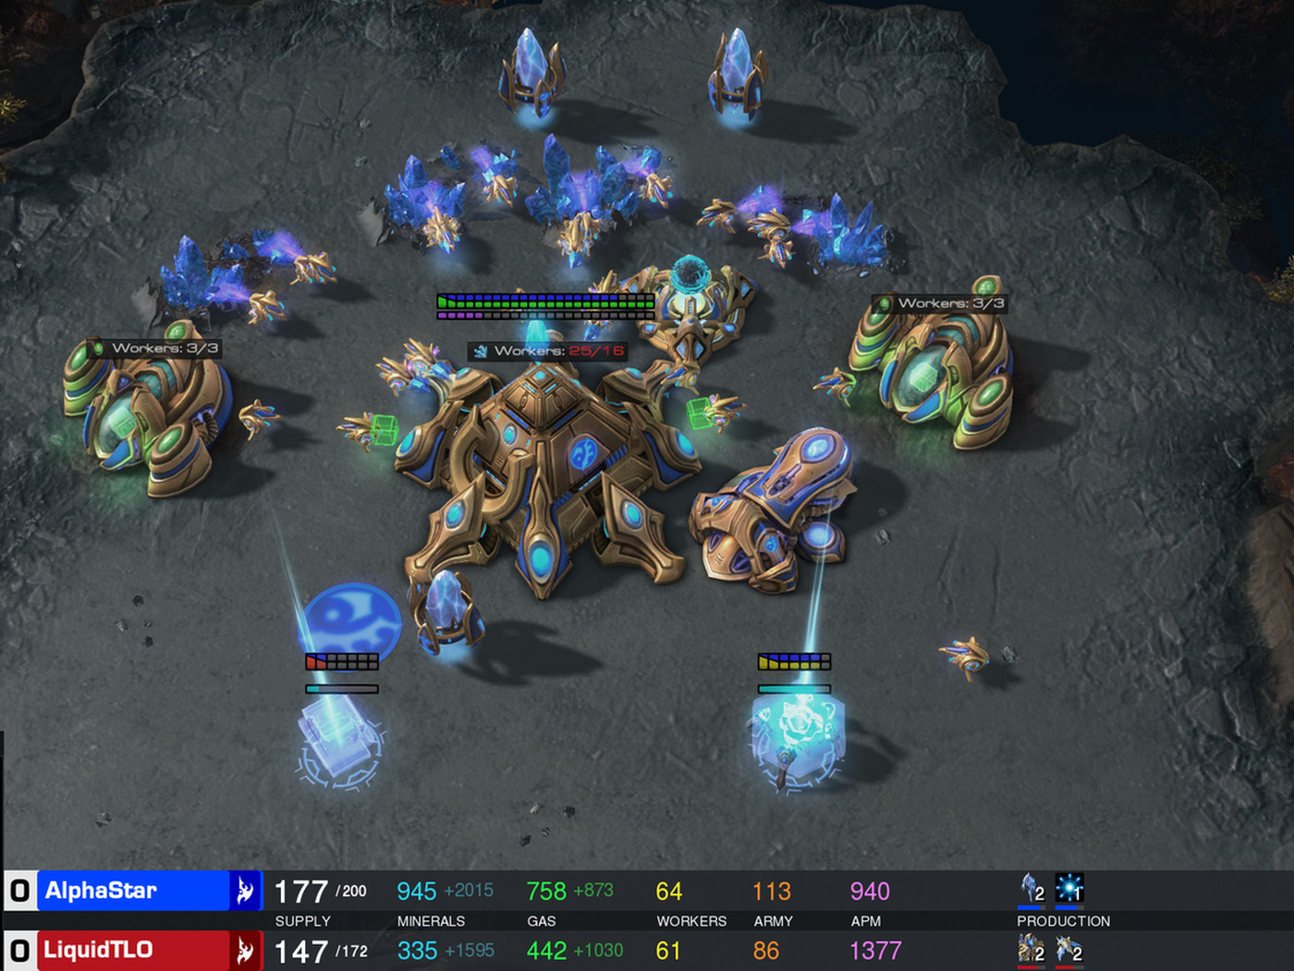
Background and Motivation for Reinforcement Learning
Reinforcement Learning (RL) is a powerful framework that trains an agent to solve complicated problems and cemented its reputation with AlphaGo’s triumph over Lee Sedol in 2016.
However, in the real and virtual world, many problem settings involve multiple players and necessitate collaboration between players.
AlphaGo vs. Lee Sedol
StarCraft II (AlphaStar)

Slide 3
Challenges in Multi-Agent Reinforcement Learning (MARL)
Credit-Assignment Problem
Non-Stationary Training
In MARL, the team of agents receives a global reward based on the agents’ joint actions.
How should we assign score to individual agent that best corresponds to the contribution of the agent’s action?
In MARL, agents are trained simultaneously and the environment changes as the agent’s policies evolve.
How should we train the agents such that they can learn to cooperatively maximize the team rewards and avoid local maxima?

Slide 4
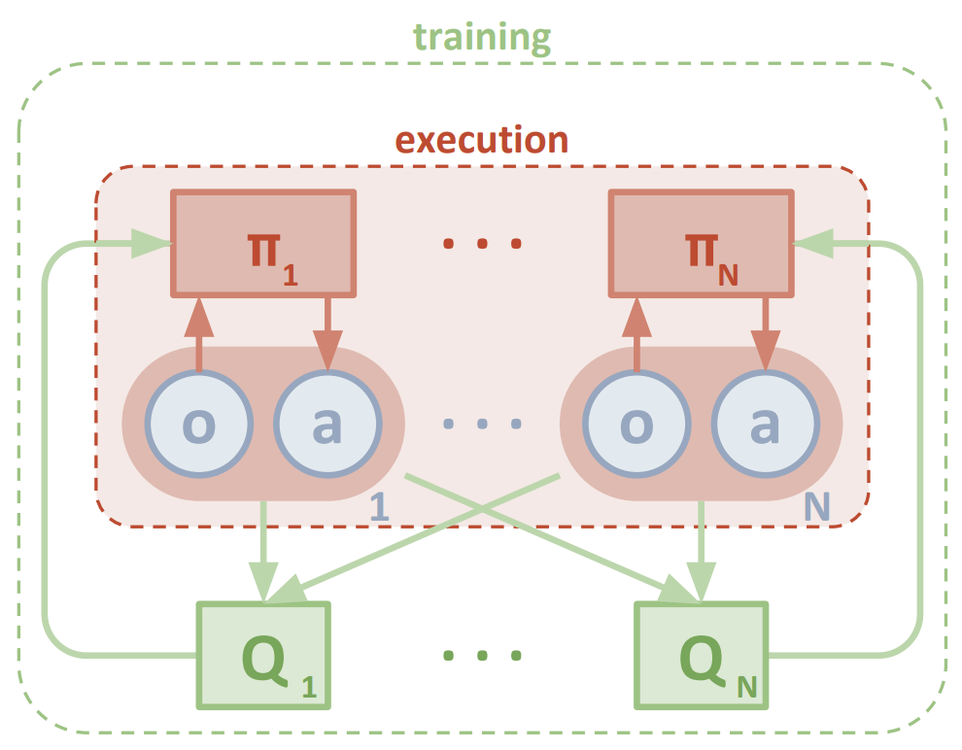
State-of-the-Art Approach in MARL: MADDPG
Multi-Agent Deep Deterministic Policy Gradient (MADDPG)
MADDPG is an extension of Deep Deterministic Policy Gradient (DDPG) actor-critic algorithm that runs on “centralized training with decentralized execution.”
In training phase, each agent’s critic receives the observations and actions from all agents as a guide for learning the optimal policy.
In execution phase, each agent uses only its own partial observation to make actions.
However, it remains unclear whether centralized critic guarantee optimal behavior between the agents?
Network Architecture of MADDPG

Slide 5
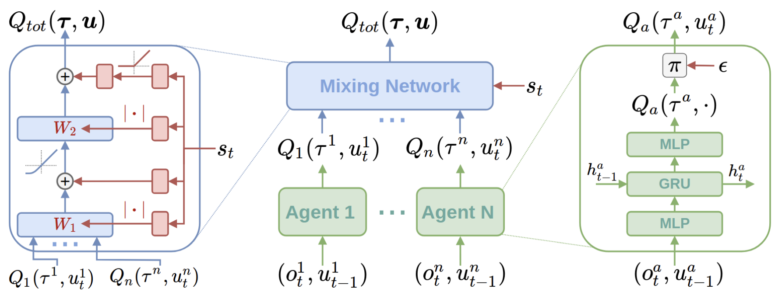
State-of-the-Art Approach in MARL: QMIX
QMIX: Monotonic Value Function Factorisation
QMIX is an extension of Q-Learning algorithm for discrete action in multi-agent setting.
QMIX enforces that the joint-action value is monotonic in the per-agent values.
It argues that the maximization of the joint action-value guarantees consistency in the agents’ policies.
Network Architecture of QMIX

Slide 6
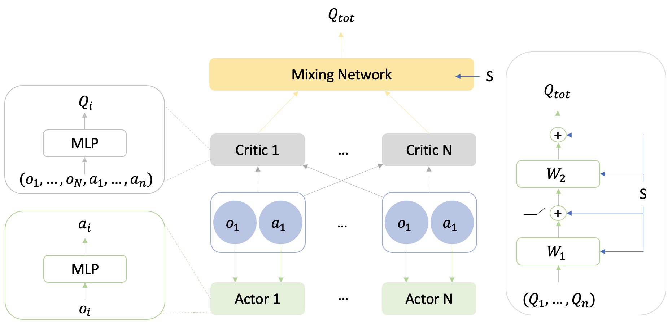
Our Proposal and Hypothesis: Deterministic QMIX
Proposal
The addition of a hypernetwork (called QMIX network) serves as a critic of the critics.
The hypernetwork receives the team’s Q values and leverages state information to output a joint Q value.
Hypothesis
The adoption of “centralized training with decentralized execution” can help overcome non-stationarity.
The non-linear (with no constraint) combination of Q values encourages cooperative behavior in the continuous action space.
Network Architecture of Deterministic QMIX

Slide 7
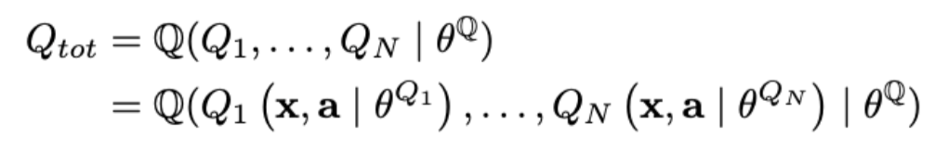
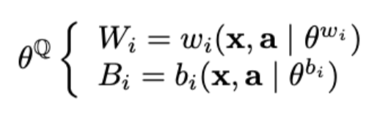
Our Proposal and Hypothesis: Deterministic QMIX
1
Joint-Value
1
The mixing network inputs individual critic value and outputs joint value.
2
2
State Information
The weights and biases of the network incorporates global state information.
Network Architecture of Deterministic QMIX

Slide 8
Experiment Setting: Multi Particle Environment (MPE)
Environment
Algorithm performance should be evaluated in environment that requires collaboration between agents.
MPE is a set of collaborative 2D games, and we will specifically focus on the predator-prey (or hide-and-seek) game.
Setting
Black circles represent environment obstacles.
Red circles are adversarial agents, who receive a positive reward for hitting the good agent.
Green circles are good agents, who move faster and receive a negative reward for being hit by adversaries.
Predator-prey scenario

Slide 9
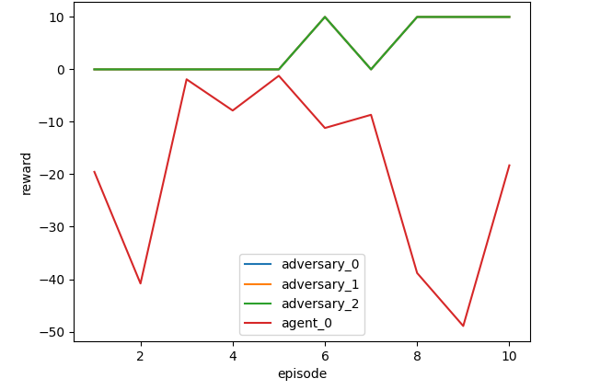
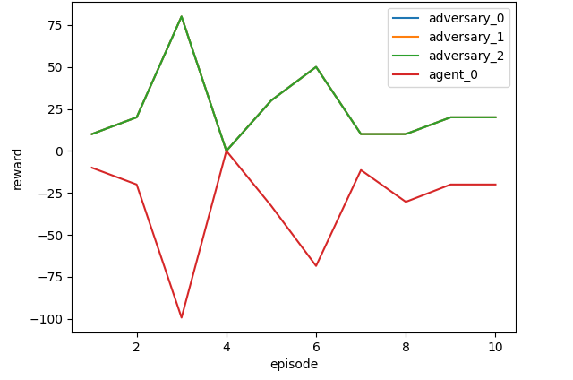
Experiment Results and Algorithm Comparison
We train the agents for 30,000 episodes (20 steps / episode) and evaluate the performance for 10 episodes.
MADDPG: the agent obtains the minimum rewards of -50, while the adversary achieves maximum rewards of 10.
QMIX: the agent obtains the minimum rewards of -100, while the adversary achieves maximum rewards of 75.
MADDPG Evaluation Performance
QMIX Evaluation Performance

Slide 10
Visualization of Agents’ Collaborative Behavior
MADDPG Performance
QMIX Performance

Slide 11
Summary of the Project’s Main Contributions
We introduce a new network architecture for multi-agent actor-critics that can generate a joint-value based on the per-agent value, without imposing any assumed constraints.
We incorporate centralized training with decentralized execution in the training scheme, whereby the agents learn continuous actions and maximize the joint-value.

Slide 12
Contribution
Both members contribute equally to the literature review, experiment (experimentation and validation), and report/presentation writing.

Slide 13
Selected References
Sutton et al. Reinforcement learning: An introduction, volume 1.
Silver et al. Human-level control through deep reinforcement learning.
Silver et al. Mastering the game of go with deep neural networks and tree search.
Silver et al. Deterministic Policy Gradient Algorithms.
Silver. UCL Course on RL.
Lowe et al. Multi-Agent Actor-Critic for Mixed Cooperative-Competitive Environments.
Rashid et al. Monotonic Value Function Factorisation for Deep Multi-Agent Reinforcement Learning.

Slide 14
Questions?

